Slide 1

Introduction to Programming Python
Peter Newhook
August 10, 2013
http://sdrv.ms/12uSLo9

Slide 2
Agenda
Programs
Basic math with Python
Types
Functions
Variables
Printing
Conditions
Loops
Data structures
Building a game

Slide 3
Introduction

Slide 4
A bit of house keeping
Ask questions at any point
Bathroom keys are on the fridge
Files located at http://sdrv.ms/12uSLo9

Slide 5
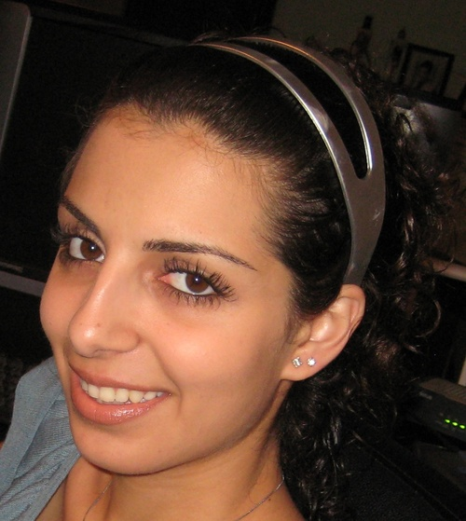
Acknowledgements
Juan Musleh - @juanmusleh

Slide 6
Quick Prerequisites Check
Python installed
Open the command line/terminal and type ‘python’
We’re going to refer to this as the ‘python shell’
Text editor
Notepad++ on Windows
TextWrangler on Mac
A burning desire to learn programming

Slide 7
You’re already a python programmer
x = 5
if x > 2:
print "I’m greater than two!"

Slide 8
Running Python
We’re going to being in the Python interpreter
Windows
Start > Programs > IDLE
Mac
Applications > Terminal > Utilities > python

Slide 9
Your First Program
print "Hello, world!"

Slide 10
What Is Python
Python is a programming language
What is a programming language?
Why do we need one?

Slide 11
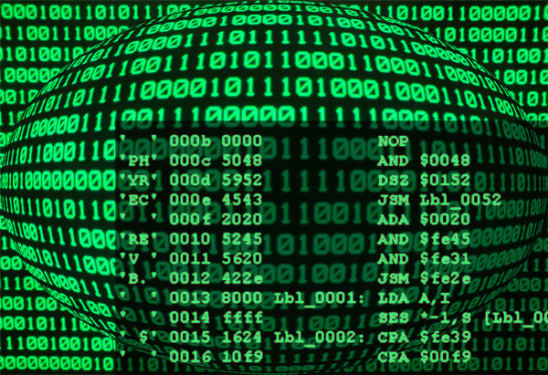
Your computer speaks another language

Slide 12
Why python is great
Easy to use: It is closer to human language than to machine language.
Powerful: It's used in academic research, Google and NASA.
Runs Everywhere: It's platform independent. You can write your program on a Mac and run it on Windows.
Free and Open Source.
Great Community.

Slide 13
Learning to Code is as Simple as ABC
Always
Be
Coding

Slide 14
Python is good at math
>>> 1 + 1
2
>>> 2 - 3
-1
>>> (345 + 3) * 9
3132

Slide 15
Math Operators
+ Addition
– Subtraction
* Multiplication
/ Division

Slide 16
Exercise: Try some math
Does Python follow order of operation rules?
Did division return the whole result?

Slide 17
We can use more than just numbers
>>> "Buenos" + " dias"
'Buenos dias'
>>> 'or I can use single quotes'
'or I can use single quotes'
>>> 'but I cannot use both"
SyntaxError: EOL while scanning string literal

Slide 18
But what if we combine text and numbers?
>>> "I'll see you at " + 2
Traceback (most recent call last): File "<stdin>", line 1, in <module> TypeError: cannot concatenate 'str' and 'int' objects

Slide 19
Types
Python is extremely picky and needs to classify everything before it knows what to do with it
“I’ll see you at “ is a String
2 is an Integer
Use the type() function to tell what type an object is

Slide 20
Types
>>> type("Ladies Learning Code")
<type 'str'>
>>> type(6)
<type 'int'>
>>> type(6.1)
<type 'float'>
>>> type(6.0)
<type 'float'>

Slide 21
Why do we need types?
Python has rules for what to do with different types of objects.
When you ask Python what 1 + 2 is:
It knows that 1 is an INTEGER
It knows that 2 is an INTEGER
It finds the instruction sheet for INTEGER
Scans the instruction sheet for +
Understands that when you ask for an INTEGER + INTEGER, you want it to add the two together
The rules for combining “hello” and “world” are different

Slide 22
Sometimes we can change types
>>> "I'll see you at " + str(2)
"I'll see you at 2"
>>> 1 + int("2")
3

Slide 23
But casting won’t always work
>>> 1 + int("two")
Traceback (most recent call last): File "<stdin>", line 1, in <module> ValueError: invalid literal for int() with base 10: 'two'

Slide 24
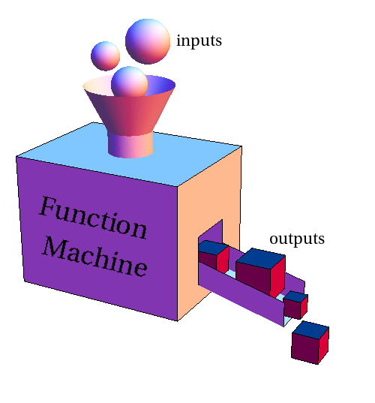
Beyond math symbols
What if you want to do something more complex than addition, subtraction, etc?
Python gives us functions to do more complex operations
Functions act on specific types

Slide 25
Number Functions
abs
pow
Hint: to figure out what a function does use the help function
>>> help(abs)

Slide 26
String Methods
>>> "toronto".capitalize()
'Toronto'
>>> "Ladies Learning Code".replace("Ladies","Girls")
'Girls Learning Code'
>>> "MOAR PYTHON!!!".lower()
'moar python!!!'

Slide 27
Try the Following String Methods
title
strip
index
split
Hint: if to find out what a method does use the help function
>>> help("f".strip)

Slide 28
But functions only work on certain types
>>> pow("elephant", "brain")
Traceback (most recent call last): File "<stdin>", line 1, in <module> TypeError: unsupported operand type(s) for ** or pow(): 'str' and 'str'

Slide 29
Quick Recap
Programming languages are intermediates between computer and human language
Programs are sets of instructions
Languages have ‘types’
string
integer
float
and lots more
Functions add behaviour
Most functions work on only one type

Slide 30
Keeping your code DRY

Slide 31
DRY
Don’t Repeat Yourself
You should only have to type anything once

Slide 32
Variables
>>> password = "SuperSecure"
>>> password
'SuperSecure'
>>> num1 = 4
>>> num1
4
>>> num2 = 1234.5
>>> num2
1234.5

Slide 33
Why variables are useful
Variable means “liable to change”
Variables change throughout the lifetime of our program
Without variables our programs wouldn’t be able to change
Setting a fixed value in a program is called ‘hard coding’

Slide 34
Let’s throw a party
>>> party_budget = 1000
>>> angel_round = 100000 >>> party_budget + angel_round
101000
What is your party budget now?

Slide 35
New Budget
>>> party_budget
1000
We have to tell the party_budget it has a new value
>>> party_budget = party_budget + angel_round >>> party_budget
101000

Slide 36
The guestlist
>>> guestlist = "Peter June Shreek"
>>> guestlist_copy = guestlist
>>> guestlist_copy
'Peter June Shreek' >>> guestlist = guestlist + " Roberto"
>>> guestlist
'Peter June Shreek Roberto'
>>> guestlist_copy
'Peter June Shreek'

Slide 37
Anything you can do to a ‘literal’ you can do to a variable
>>> startup = "my elephant brain" >>> startup.title()
'My Elephant Brain'
>>> revenue = -429376
>>> abs(revenue)
429376
>>> revenue + 1000000
570624

Slide 38
But did the variable change?
>>> startup
'my elephant brain'
The function returned a new value, it did not change the original value.

Slide 39
Exercise
Try using the math operators we saw earlier on variables

Slide 40
Some more strings
>>> combined = "combined"
>>> "Strings can be "+ combined + " with variables."
'Strings can be combined with variables.'
>>> fun = "not fun"
>>> "But it is " + fun
'But it is not fun'

Slide 41
String Format method
>>> utensil = "spoon"
>>> "My {} is too big".format(utensil)
'My spoon is too big'
>>> "The {0} came before the {1}".format('chicken', 'egg')
'The chicken came before the egg'
>>> "The {1} came before the {0}".format('chicken', 'egg')
'The egg came before the chicken' >>> template = "The Jaguar F-Type has {}hp"
>>> template.format(488)
'The Jaguar F-Type has 488hp'

Slide 42
Exercises (for later)
Use multiple placeholders but only one argument
Round Pi to 3 decimals
Print centered text
' centered ‘
Print centered text and pad with plus signs
'+++++++++++centered+++++++++++'
Look at http://docs.python.org/2/library/string.html#formatstrings for help

Slide 43
Recap
Variables save us from repeating ourselves
Anything you can do to a literal you can do to a variable
Variables don’t change until you tell them to
Formatting strings with the plus sign (+) is error prone
Use str.format()

Slide 44
Honest to Goodness Programs

Slide 45
Files
So far we’ve been typing out our entire program
But when you run real programs (like Chrome or Outlook) you don’t write all the lines
We need to put repeatable code in a file

Slide 46
Programs in a File
Create a folder named exercises somewhere on your computer
Open your text editor
Create a new file called party.py
Add the following code
party_budget = 1500
party_budget

Slide 47
A quick lesson about the command line
To run Python on the command line you’ll have to move around
To change the directory(folder) we type cd <directory name>
To move one directory up we type cd ..
That’s all the command line wizardry you need to know today

Slide 48
Running your program
On the command line, go to the exercises folder
Type python party.py
Wait, where’s my party budget?

Slide 49
In programs, you have to tell Python to print
party_budget = 1500
print party_budget

Slide 50
Shouldn’t print be a function?
Oh boy, now you’ve stepped in it.
It should
And in Python 3 it is
But there’s still a lot of code that uses Python 2.x
So for now, just use print like a statement

Slide 51
Getting fancy with special characters
print "215 Spadina"
print "Toronto"
print "Ontario"
print "215 Spadina \nToronto \nOntario"

Slide 52
Other Special Characters
\n
\'
\"
\\
\t

Slide 53
Comments
Python ignores anything after the # character
# This is a comment
print 'Hello World' # so is this
# print("this won't be printed")
Notes:
The proper name of the hash symbol (#) is the a octothorpe

Slide 54
Asking for Input
#raw input prompts the user
raw_input("Please enter your name:\n")
#store the result in a variable
my_name = raw_input("Please enter your name:\n")
#store the result in a variable
my_age = int(raw_input("How old are you?\n"))

Slide 55
A Ticket App
We’re going to write a ticket app for Peter’s Python Prognostications
Here’s how it’s work
We start with 8 tickets
We ask the user how many they want
We print out that number
We show the user how many tickets are left
Check tickets1_begin.py if you’re stuck

Slide 56
Issues you may have had
raw_input always returns a string
You’ll need to cast it to an int
Did you forget to close a quotation mark?
It happens to the best of us
num_tickets wasn’t updated
You have to explicitly update the number
This is called tracking ‘state’

Slide 57
Is it working
Good
Now break it

Slide 58
It depends
Introduction to conditions

Slide 59
Control Flow
Programs don’t run line by line from start to end
They jump around according to rules
One way to specify those rules is to use conditions

Slide 60
Conditional Logic
We frequently want to test if two values are equal
For equality we use the double equal sign
1==1
We can test if two things aren’t equal with !=
1!=2
There are also many of the math operators we know
Greater than: >
Greater than or equal to: >=
Less than: <
Less than or equal to: <=

Slide 61
Exercise
In the Python shell use all the operators on the previous slide

Slide 62
Boolean types
Either true or false
Useful when making a decision

Slide 63
If statement
if 1==1: print "I am the walrus!"

Slide 64
Beautiful is better than ugly (indentation)
# so beautiful if True: print "I am the egg man!" # my eyes! if True: print "coo coo ca choo!"

Slide 65
else Statement
if 0: print "0 is always false" else: print "So the else clause is executed"

Slide 66
elif statement
today = "Saturday" if today == "Friday": print "Everybody’s working for the weekend!" elif today == "Saturday": print "S-A-T-U-R-D-A-Y Night!" elif today == "Sunday": print "Pancakes." else: print "Early to bed and early to rise."

Slide 67
Exercise
Stop the user from buying tickets if they ask for more than are available

Slide 68
What we’ve covered
Programs
Basic math with Python
Types
Functions
Variables
Printing
Conditional logic

Slide 69
Morning Recap
Write a program that asks you what your favourite colour is and tells you something else that is the same colour
What is your favourite colour? Green I like turtles
Write a program that prints a string if the input is less than 10 or greater than 20
Do the same thing for greater than 10 and less than 20

Slide 70
Colour
fav = raw_input('What is your favourite colour?\n')
fav_lower = fav.lower()
if fav_lower == 'green':
print 'I like turtles'
elif fav_lower == 'blue':
print 'Like the sky'
elif fav_lower == 'purple':
print 'My favourite ice cream when I was young was called Purple People Eater'
else:
print "{} is my favourite too.".format(fav)
Notes:
Some things to pay attention to
\n in raw_input
fav.lower()
Double equals sign
Indentation
elif for multiple conditions
else clause if no other condition is met
str.format in the last statement

Slide 71
and/or
input = raw_input("Give me a number: ")
input = int(input)
if input < 10 or input > 20:
print 'That\'s a good number'
if input > 10 and input < 20:
print "You've found the sweet spot"
Notes:
Take note:
Casting input to an int
Or
And
Escaping the ‘
Colon after condition

Slide 72
Getting loopy

Slide 73
Loops
So far our code has run from top to bottom
Programs usually need to do something over and over agin
Computers don’t mind doing repetitive tasks

Slide 74
While Loop
#"while" something is true
#perform an action
while True:
print 'Are we there yet?'
#use Ctrl + c to cancel the program

Slide 75
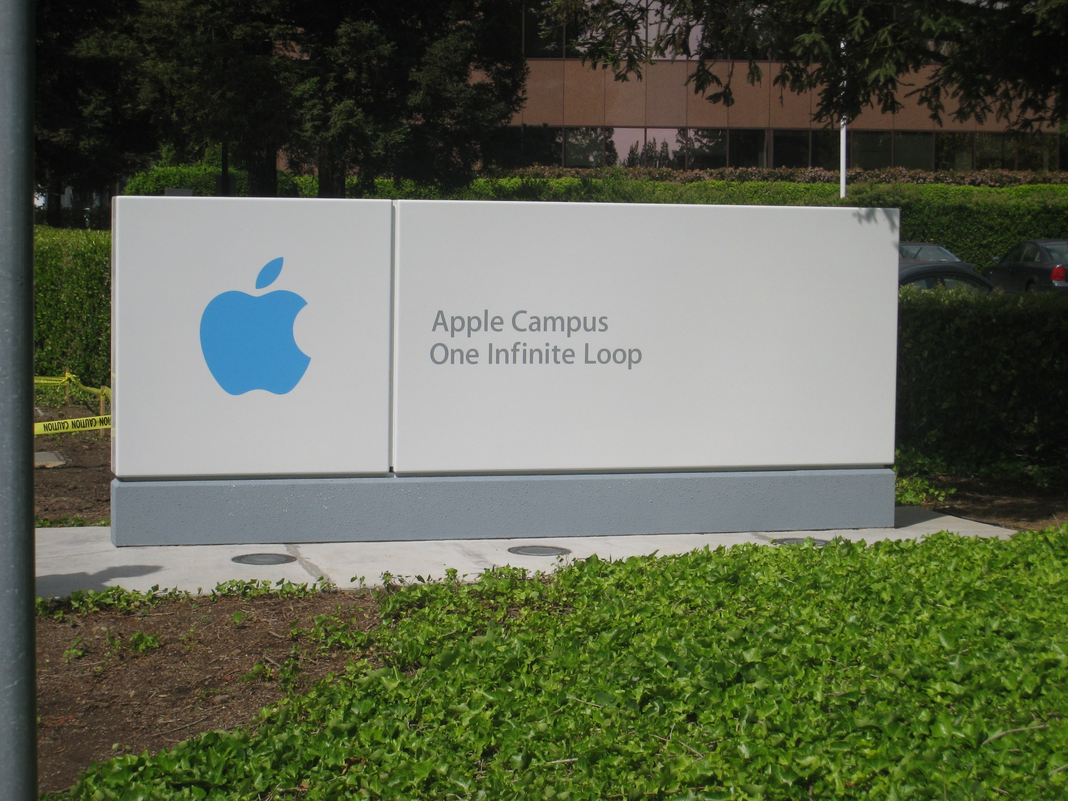

Slide 76
We need a way to stop the loop
#code within the loop my invalidate the condition loop = True
while loop:
print 'Are we there yet?'
loop = False
print 'Done the loop'

Slide 77
Or we could ask the user for input
loop = True
while loop:
answer = raw_input('Are we there yet?')
loop = answer == 'no'
print 'Done the loop'

Slide 78
break dancing
#or we can use the break keyword
loop = True
while loop:
print 'Are we there yet?‘
break
print 'Done the loop'

Slide 79
To run a certain number of times we test a variable and increment within the loop
x = 1
while x < 10:
print x
x += 1

Slide 80
Exercise: Print from 10 to 1
x = 10
while x > 0:
print x
x -= 1

Slide 81
Guided Exercise
We’re going to write a game for the computer
The computer will pick a number and we have to guess it
from random
import randint x = randint(1,10)
The user should know if they are too high or too low
We know how to ask for input
We know how to compare guesses
We want to give the user multiple chances

Slide 82
Data structures

Slide 83
Lists
Lists are lists
That was useless
But seriously, they’re just a set of objects
Lists can hold strings, integers, floats, booleans, and anything else you can create

Slide 84
Creating Lists
mylist = [1,2,3,4]
print mylist #[1, 2, 3, 4] companies = ['My Elephant Brain', 're:3D', 'Hacker You']
print companies
#['My Elephant Brain', 're:3D', 'Hacker You']
kitchen_sink = [1 , 'a', True]
print kitchen_sink
#[1, 'a', True]

Slide 85
Accessing Items in a List
>>> companies[1]
're:3D'
>>> companies[-1]
'Hacker You'
>>> companies[10]
Traceback (most recent call last): File "<stdin>", line 1, in <module> IndexError: list index out of range

Slide 86
Exercise
Using a list and a while loop, print the days of the week
‘break’ the loop on Wednesday

Slide 87
Modifying a List
#add and item
l.append(5)
print l
#remove and item
l.remove(3)
print l # remove throws an error if the item doesn't exist
l.remove(9)

Slide 88
A Quick jump Back to Loops
# for loops make it easy to loop over a list for company in companies: print company
# they're also useful for looping # a konwn number of times for i in range(1,10): print i

Slide 89
Exercise
Use a for loop to print the days of the week
Use a for loop to count from 10 to 1
Hint: by default range() increases by 1 each time, but you can give it a third argument to tell it the number to increment by each time
E.g range(0, 10, 2)

Slide 90
The Grand Finale

Slide 91
Hangman
Let's make a hangman game using what we learnt today.
But before you start coding away, it helps to think about what you're trying to do.
Remember, computers need specific instructions, so you need to break it down.
You can start by playing hangman on paper with each other.
Start with hangman_draft.py

Slide 92
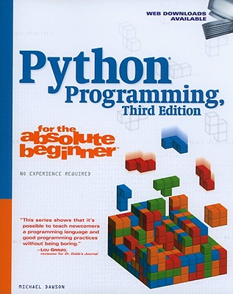
Hangman credit to Python Programming for the Absolute Beginner

Slide 93
You’re programmers now!
Sure there’s more to know
There’s always more to know
The trick is using what you know
http://www.pyschools.com/
http://www.djangobook.com/en/2.0/index.html
http://learnpythonthehardway.org/

Slide 94
Congratulations!
Thank-you Ladies Learning Code
Thank-you mentors
And thank-you participants

Slide 95

Creative Commons By Attribution
http://creativecommons.org/licenses/by/3.0/deed.en_US

Slide 96
Putting the ‘fun’ in functions!

Slide 97
Functions
# we put reusable code inside 'functions‘
def add_two(a, b):
return a + b
ans = add_two(1, 2)
print ans

Slide 98
Exercise
Write functions to do the following
Multiply two numbers
Combine an int and a string
Print the sequence of a given number, down to zero
5, 4, 3, 2, 1, 0

Slide 99
Modules

Slide 100
Python code is reusable by other code
# start python in the same folder as functions.py
from functions import add_two
print add_two(1,2)
# from math import factorial

